Slide 1
Introduction to the Local Alcohol Policy
  Briefing with councillors February 2025

Slide 2
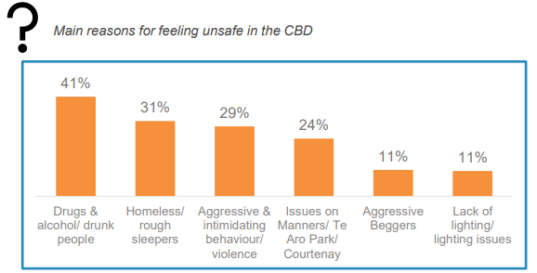
Context - City Safety Plan
Elected members have been briefed late 2024 on a plan to address ongoing safety issues and concerns in the central city. The City Safety Plan will be presented to Council in March 2025.
Drug and alcohol-related harm are the top reported factors contributing to public perceptions of unsafety in the central city (Residents’ Monitoring Survey 2024).
Development of a Local Alcohol Policy is a component of the upcoming City Safety Plan – to mitigate alcohol-related harm and enhance public safety.

Slide 3
Where does a Local Alcohol Policy fit?
Urban Design
Harm prevention and reduction
Alcohol Bans
Business support
LAP and alcohol licensing
One of many measures that work together to address alcohol-related harm and safety issues
Enforcement
Transport Options
Street Management

Slide 4
What does evidence tell us about alcohol-related harm in the city?

Slide 5
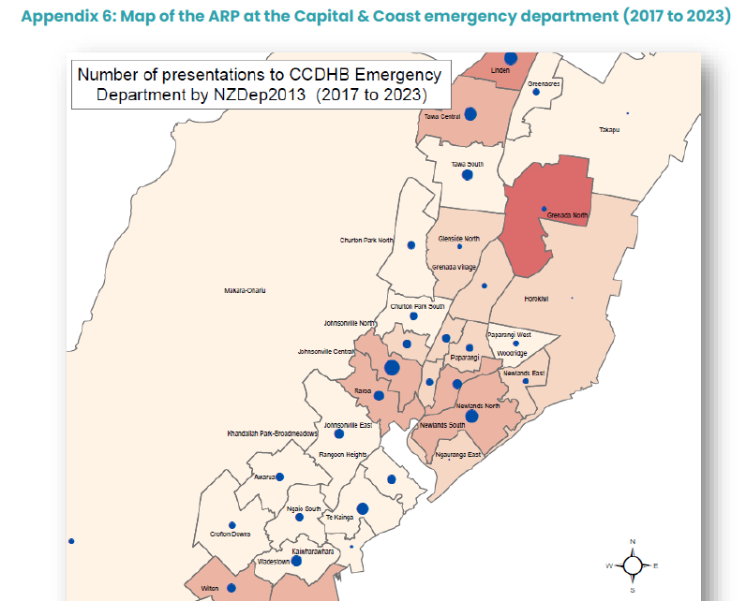
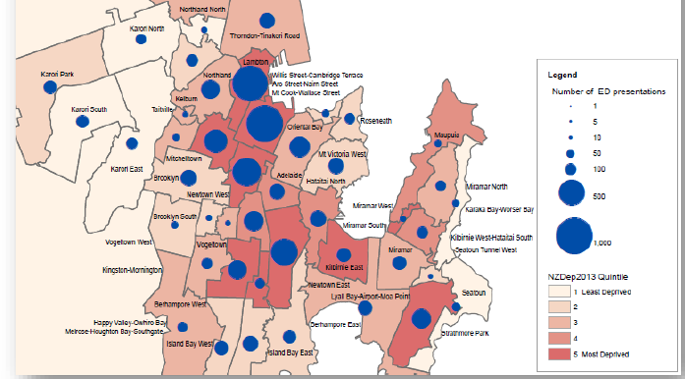
Alcohol-related ER attendances
Emergency room admissions related to alcohol occur more frequently for people who reside in the central city and in areas of greater socioeconomic deprivation.

Slide 6
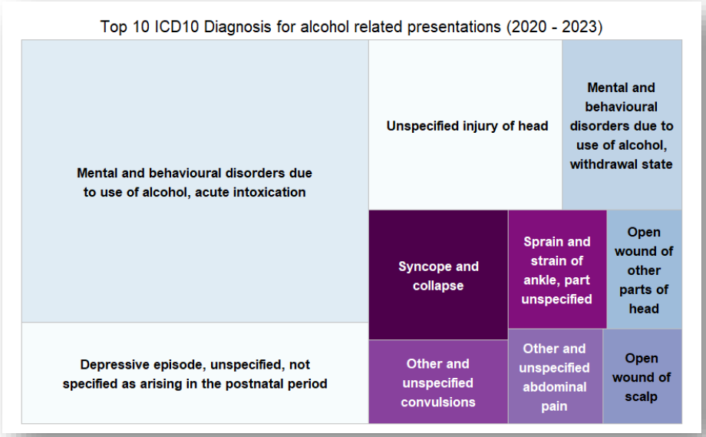
Alcohol-related ER attendances
Most emergency room admissions related to alcohol are due to acute intoxication, followed by depressive episodes, head injury, and alcohol withdrawal.

Slide 7
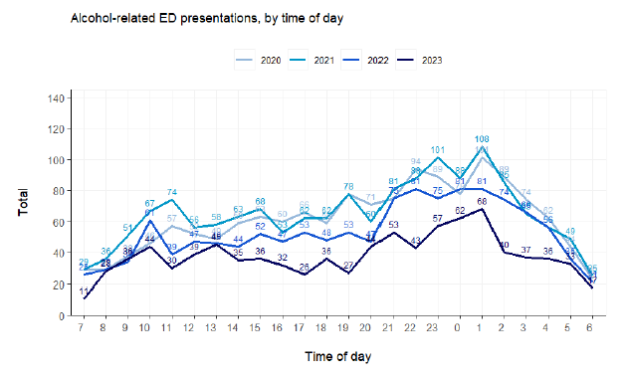
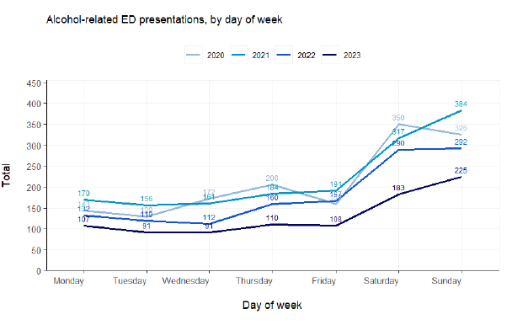
Alcohol-related ER attendances
Emergency room admissions related to alcohol occur more frequently later in the evening (between 8pm and 2am) and on weekends (Saturday and Sunday).

Slide 8
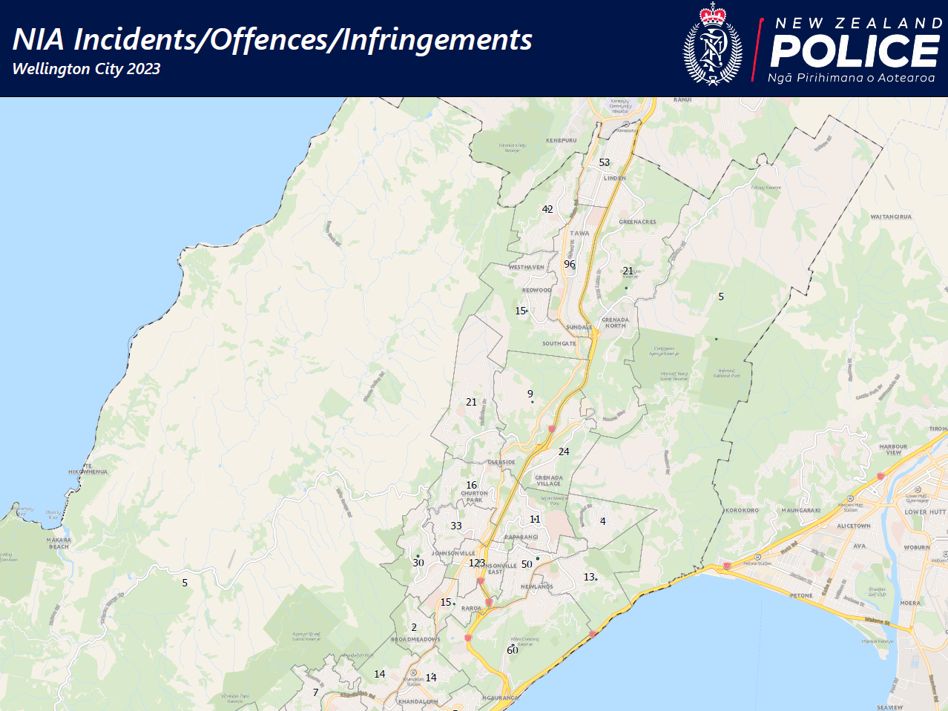
Alcohol-related Police incidents

Slide 9
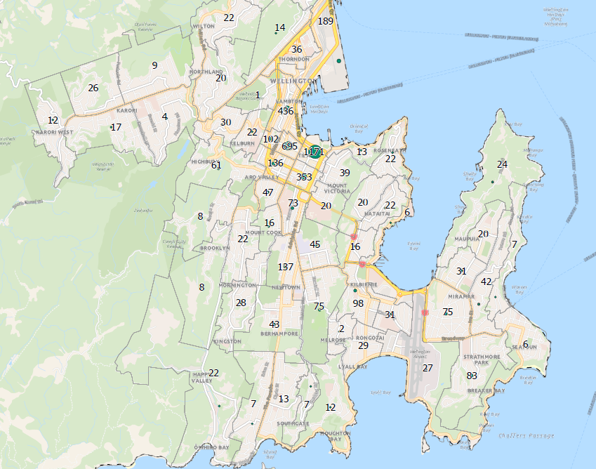
Alcohol-related Police incidents
Most alcohol-related Police incidents occur in the central city (Te Aro).

Slide 10
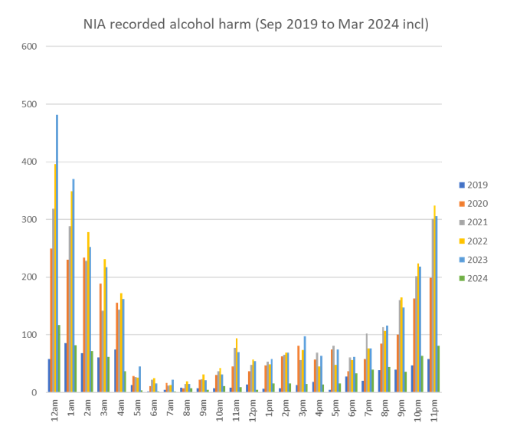
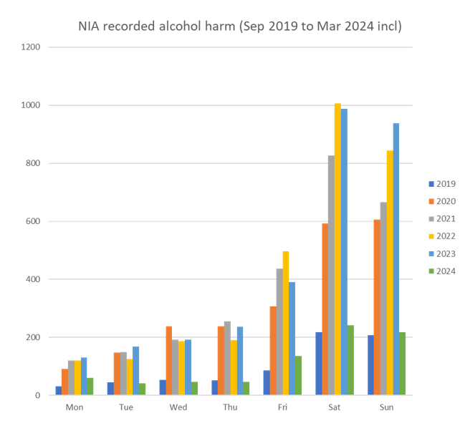
Alcohol-related Police incidents by time and day
1km radius – Taranaki St and Courtenay Place
In the central city, alcohol-related Police incidents occur more frequently later in the evening (9pm to 5am) and in the weekend (Saturday and Sunday).

Slide 11
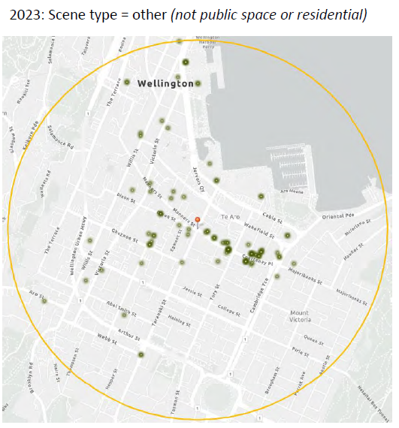
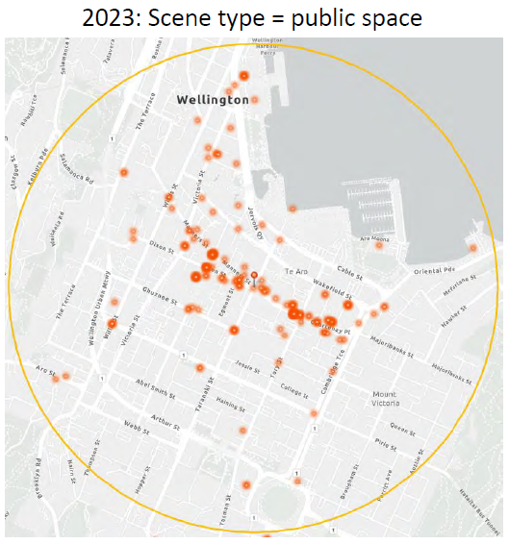
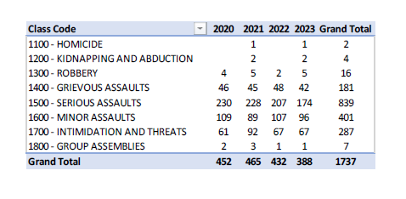
Alcohol-related violence incidents by time and day
1km radius – Taranaki St and Courtenay Place
In the years 2020 to 2023, around 45% of alcohol-related violence incidents recorded by the Police in Wellington were within 1km of the corner of Taranaki St and Courtenay Place (the central city).
Most of the alcohol-related violence incidents occur in public space and are clustered on busy central streets (Courtenay Place, Manners Street, Dixon Street).

Slide 12
City Centre at night-time
Current reported issues in the night-time entertainment precinct:
At late hours (12am and onward in the weekends)
Over-intoxication of patrons – attributed to frequent pre-loading (drinking in private locations before attending on-licensed venues).
Crowding outside of on-licensed premises on the street and queueing.
Exacerbation of alcohol-related harm and disorder by these factors, such as fights, assaults, sexual violence, vandalism.

Slide 13
City Centre at night-time
WCC actions to address these issues:
Outside of alcohol licensing or a Local Alcohol Policy (to control the supply of alcohol).
Attendance by officers at Courtenay Place accords (initiated and organised by hospitality premises in the precinct) – to work with hospitality on public space management.
Bystander training for bar staff to reduce impacts of sexual violence in venues.
Funding Take10 sites for intoxicated people to rest and refuel.
Partnerships providing presence of Māori wardens.
Highly visible alcohol ban awareness campaign in the CBD (Know Your City Limit).

Slide 14
City Centre at night-time
WCC actions to address these issues (continued):
Outside of alcohol licensing or a LAP (to control the supply of alcohol).
Improvements to public space amenity – lighting and CPTED (Crime Prevention Through Environmental Design) analysis to upgrade spaces which are known pre- and side-loading hot spots, such as Bunnings carpark and Reading Cinemas carpark.
Development of the Courtenay Place Precinct Plan in collboration with businesses to contribute to an improved experience and reputation - such as diversifying the offering through public events, live entertainment, and creative installations.

Slide 15
Any questions?

Slide 16
How is alcohol regulated?
The Sale and Supply of Alcohol Act 2012 sets out the licensing framework for the sale and supply of alcohol.
The District Licensing Committee (DLC) for Wellington city is appointed by the Council to make decisions on alcohol licence applications.
  Licensing inspectors and representatives from NZ Police and Health NZ report on applications to the DLC.
There are four types of licences (on-licence, off-licence, club licence, special licence) with different conditions for their sale and supply of alcohol.
Any business or organisation that wishes to sell or supply alcohol must first have a licence.

Slide 17
Alcohol Licensing in Wellington city
As of November 2024:
704 alcohol licences in total.
  542 on-licences (where alcohol is consumed on-site).
    262 are restaurants.
    157 are taverns (the legal name for premises that sell primarily alcohol, such as bars or pubs).
  110 off-licences (where alcohol is purchased to take away)
    30 are bottle stores.
    23 are grocery stores.
    20 are supermarkets.
  52 club licences (for example, sports clubs, RSAs).

Slide 18
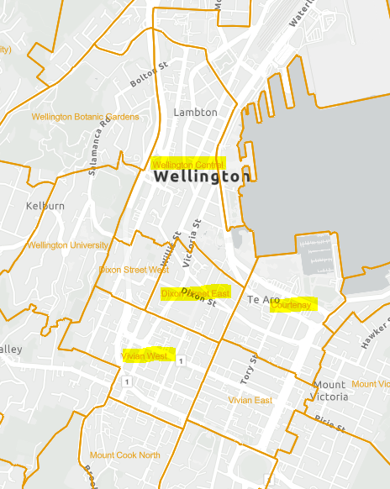
Alcohol Licensing in Wellington city
The SA2s (Statistical Areas) in Wellington with the highest numbers of active alcohol licences are (as of November 2024):
Courtenay – 99 licences.
Dixon Street East – 95 licences.
Wellington Central – 73 licences.
Vivian West – 62 licences.
Of these 319 licences (45% of total licences in Wellington city):
136 are on-licensed restaurants.
102 are on-licensed taverns (the legal name for bars, pubs and other premises that primarily sell alcohol).
8 are off-licensed bottle stores.
6 are off-licensed grocery stores.
3 are off-licensed supermarkets.
41 premises are licensed until 4am (out of 61 across the city that are licensed until 4am).

Slide 19
Current problem definition
To support the development of a new Local Alcohol Policy proposal.
The Council currently does not have a LAP, and the local District Licensing Committee (DLC) applies the provisions of the Act on a case-by-case basis for all decisions on new and renewing licences.
In 2023 and 2024, 37 oppositions or objections were lodged against licence applications, by the reporting agencies (NZ Police, Medical Officer of Health, licensing inspectors) or members of the public.
Delays in DLC decision-making and significant additional costs can occur when applications are objected to, and licensees may find it difficult to know how the Act will be applied to their application if there is no set policy to guide DLC decisions.
Licensees also report that in their view it is not clear or consistent what would influence an application to be objected to or declined. A LAP would give licensees more guidance on these matters.

Slide 20
What is a local alcohol policy?
The Sale and Supply of Alcohol Act 2012 allows local councils to develop local alcohol policies (LAPs).
A LAP is a set of policy decisions made to manage the availability of alcohol, and meet the object of the Act, that:
    the sale, supply, and consumption of alcohol should be undertaken safely and responsibly; and
    the harm caused by the excessive or inappropriate consumption of alcohol should be minimised.
LAPs are optional; councils do not have to have one.

Slide 21
What can a LAP do?
A LAP can provide greater certainty for applicants about how the DLC could consider individual licensing decisions. A LAP can:
  Take into account up to date evidence and community views and preferences.
  Better align with regulatory agencies’ licensing positions (Police, Medical Officer of Health, licensing inspectors).
District licensing committees (DLCs) must have regard to the elements of a LAP in the district when:
  Deciding on whether to issue new licences (including special licences if applicable).
  Varying conditions of existing licences.
  Renewing existing licences (as of the Community Participation Amendment Act).
DLCs can refuse licences if they are inconsistent with the LAP, or issue licences subject to conditions consistent with the LAP.

Slide 22
What rules might be in a LAP?
Councillors will determine the provisions/rules that will be in a proposed LAP.
Under the Act, a LAP can contain any of the following rules that can:
Limit the location of licences in particular areas or near certain types of facilities.
  Such as in specific neighbourhoods or near schools, health facilities, marae or social housing.
  Or how close licences can be to each other.
Limit the density of licences by specifying whether new licences or types of licences should be issued in a particular area.
Impose conditions on groups of licences, such as:
  A 'one-way door' condition - you can leave an on-licensed or club licensed premise but not enter or re-enter after a set time.
  Discretionary conditions for issuing licences such as limiting single unit sales from off-licensed retailers (for example, one can instead of a six-pack).
Restrict or extend the maximum opening hours set in the Act.
Have different conditions for different areas.

Slide 23
History - 2013 Provisional LAP
We developed a provisional LAP in 2013 after extensive stakeholder engagement and research.
  Appealed by – Inner City Association, Medical Officer of Health, Capital and Coast DHB, NZ Police, Mermaid Bar, Foodstuffs Ltd, Progressive Enterprises Ltd, Super Liquor Holdings Ltd.
Appeal hearings with Alcohol Regulatory and Licensing Authority (ARLA) were held in late 2014.
The Council resolved in 2016 to remain with the default licensing settings in the Act and to not resubmit the LAP.

Slide 24
Recent changes to the LAP framework
The Sale and Supply of Alcohol (Community Participation) Amendment Act 2023 – removed the appeal process for provisional LAPs, which was an additional policy step after consultation and adoption.
The appeal process prevented more widespread adoption of LAPs across the country – at the time of the bill two-thirds of the population was not covered by a LAP (Auckland, Hamilton, Wellington, Christchurch did not have a LAP).
Appeals were mostly lodged by supermarkets and bottle stores and were costly to ratepayers to resolve – many councils abandoned their provisional LAPs.
Auckland Council pursued all appeals up to the Supreme Court following judicial review – final ruling given in 2023, LAP adopted in August 2024.
WCC submission on the bill – supported the removal of appeals.

Slide 25
Other councils’ experience
Smaller district councils and rural councils have found it easier to adopt LAPs – less opposition from industry. Alcohol Healthwatch in 2022 reported that 41 out of 67 councils in the country had a LAP and the majority were smaller district councils.
Metro and larger city councils:
Experienced significant pushback from industry.
Had delayed or abandoned their LAPs due to appeals.
Have to balance community wellbeing objectives:
  24-hour economy objectives (employment, events, tourism, GDP).
  Social wellbeing purpose (alcohol harm management) of a LAP (regulation, public health and safety).

Slide 26
Other councils
Wellington Region
Operative LAPs – Hutt City (Lower Hutt), Porirua City, Wairarapa (joint across 3 councils)
In development – Kapiti Coast
Under consideration – Upper Hutt
Metro councils
Operative LAPs - Auckland, Tauranga, Dunedin
In development – Christchurch
Under consideration – Hamilton

Slide 27
National default licensing rules
If no LAP is in force for the district.
Default national maximum trading hours (for the sale and supply of alcohol on premises):
On-licences and club licences – 8am to 4am the next day.
Off-licence retailers – 7am to 11pm.
All licence applications are determined on a case-by-case basis by the District Licensing Committee based on the criteria in the Act.
No specific limits on number, location, or type of licences.
Maximum trading hours and one-way door conditions may be negotiated for individual licences.

Slide 28
Key LAP rules in Wellington region
Council | On-licences | Off-licences | Other
Hutt City (2024) | Taverns/hotels/nightclubs/function centres: CBD & Jackson St, Petone Maximum hours 7am to 3am 1 year probation with 1am closing for new licences Outside of this area Maximum hours 7am to 1am 1 year probation for new licences | Maximum hours 7am to 10pm Maximum number of off-licences: Naenae – 4 Stokes Valley – 3 Taita – 3 Avalon – 1 Hutt Central – 11 Wainuiomata - 6 | Discretionary conditions regarding special licences (e.g. no glassware outside, plastic containers or cans, promotion of responsible alcohol use)
Porirua City (2018) | Maximum hours 8am to 2am On-licence hotels can trade at any time on any day to lodgers Same rules apply to club licences, except RSAs can trade from 4am to 1pm on ANZAC day | Maximum hours 7am to 10pm Off-licence remote sellers can trade at any time on any day | All licences except supermarkets will not be granted in close proximity to sensitive sites (schools, drug/alcohol treatment providers)
Wairarapa District Councils (2024) | Maximum hours 8am to 1am Hotel in-bedroom (mini-bar) and/or lodgers sales have 24 hour trading Discretionary condition for BYO restaurants to require a duty manager during busy periods e.g. Thursday, Friday, Saturday nights | Maximum hours 7am to 10pm - supermarkets and grocery stores All others 9am to 10pm No new licences granted within 100m of sensitive sites (except supermarkets, grocery stores) | Maximum hours 8am to 11pm for Sports Clubs 8am to 1am for other Club licences Special licences will not be granted for events focused on children

Slide 29
Key LAP rules in metro councils
Council | On-licences | Off-licences | Other
Auckland (2024) | Maximum hours 8am to 4am in the City Centre 8am to 3am for the rest of the region | Maximum hours 7am to 9pm Temporary freeze on new licences in the City Centre and Priority Overlay areas for 24 months Rebuttable presumption against new licences in Neighbourhood Centres | Club licences maximum hours 9am to 1am Special licences should not exceed maximum hours for on-licences in the area
Tauranga (2024) | Maximum hours 9am to 2am in the city centre 9am to 1am elsewhere Same rules apply to club licences | Maximum hours 7am to 10pm No new licences issued for bottle stores within suburbs with a social deprivation index of 9 or 10 | Discretionary conditions for special licences (e.g. limit of drinks sold per transaction, no high alcohol shots)
Dunedin (2018) | In non-residential areas: Hotels, taverns 8am to 3am One-way door at 2.30am Restaurants/cafes 8am to 1am Entertainment premises require live entertainment and door charge Hours 5pm to 4am One-way door at 2.30am | Maximum hours 7am to 10pm Exception to sale restriction on Easter Sunday – grape, fruit or vegetable wine made on the premises or where produce is grown on the land e.g. a vineyard | Licences for new hotels, taverns or bottle stores will not generally be granted if they are within 100m of a sensitive facility likely to attract young people, such as schools and playgrounds

Slide 30
Any questions?

Slide 31
What do Wellington residents think?
A panel survey (~900 respondents) of Wellington residents in May-June 2024.
Summary of notable results:
The most common pattern of drinking is a moderate one (2-4x a month, 1-2 standard drinks each time).
The most popular place to buy alcohol from is the supermarket, followed by pubs/bars/nightclubs.
Most people agree that alcohol has an important social/economic role in the city.
Pubs/bars/nightclubs are seen as places where most alcohol-related harm occurs, followed by public events, public spaces, and private residences.
The most common type of harm respondents report experiencing is feeling unsafe in a public place due to another person’s drinking (44%).
Opinions are split on the idea of limiting the number of licensed premises, but lean towards agreement.
Most people think the alcohol sale hours for off-licensed premises are about right. Opinions are split on sale hours for on-licence premises between about right and a bit/much too long.

Slide 32
What do Wellington residents think?
A panel survey (~900 respondents) of Wellington residents in May-June 2024.
Summary of notable results (continued):
Most respondents agree that there should be restrictions on how close some licensed premises are to sensitive sites, particularly for bottle stores and pubs/bars/nightclubs.
  Of those who agree, the priority sites are early childhood education centres and primary schools, secondary schools/colleges, medical/rehabilitation facilities and hospitals, and parks/playgrounds/sports facilities.
Opinions are split on restrictions on how close some licensed premises are to each other, with a tendency towards disagreement.
Opinions are split on whether there should be one-way door restrictions, tending to agreement.
The most common reason given for agreeing with suggested alcohol management measures was for harm reduction.
  The most common reasons given for disagreeing is either a view that the Council shouldn’t intervene in the market, or that it wouldn’t work/would cause more harm.

Slide 33
Timeline of proposed policy stages
2023 - completed
2024 - completed
February – WCC submitted on the Sale and Supply of Alcohol (Community Participation) Amendment Bill.
June to September - Began engagement with other councils in Wellington region and metros.
August – Community Participation Amendment Act received Royal Assent.
October – LAP approved as an upcoming item on the Strategy and Policy work programme by Council.
November to December – Scoping and planning policy project.
January to December – Research and evidence collation and analysis (s78(2) of the Act).
May to June – Public survey on alcohol attitudes and experiences in Wellington.
2025
February – Briefing to councillors.
April to June – Early engagement with agencies (required under the Act), the sector, community groups.
August – Follow-up councillor briefing.

Slide 34
Timeline of proposed policy stages
2026
Implementation
February – Councillor workshop on policy options and seeking approval to consult on a draft LAP.
March to May - Public consultation using the Special Consultative Procedure.
June – Approval of provisional LAP by Council, final policy publicly notified.
July – Final LAP is adopted 30 days after the date it is publicly notified. The LAP is brought into force by resolution following adoption.
September – (If applicable) provisions regarding maximum trading hours and one-way door policies come into effect (90 days after policy comes into force).
LAP to be evaluated following its implementation.
Legislated six-yearly review timeframe – will need to consult on amendments to the LAP using the Special Consultative Procedure.

Slide 35
Questions?
Next steps – engaging stakeholders, developing the draft LAP and implementation.

