Slide 1

Local Alcohol Policy
Briefing with councillors 8 April 2026

Slide 2
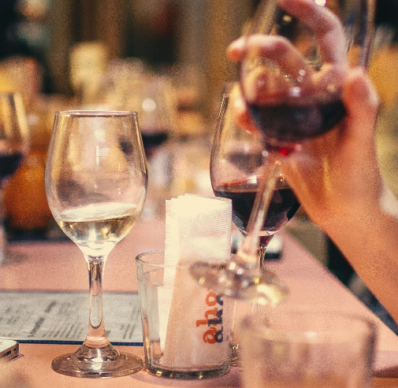
Agenda
Background
Benefits of a LAP
Process and next steps
Licensing in Wellington
Pattern of alcohol harm in Wellington
Community views
Amendment Bill

Slide 3
Where we are currently (status quo)
We regulate alcohol through licensing under the Sale and Supply of Alcohol Act 2012.
  National framework, criteria, and rules.
  Case by case assessment for every licence application and renewal by the District Licensing Committee.
  Negotiating licence conditions through oppositions or objections and hearings
  Can lead to delays in application process, extra costs for applicants and the Council.
We have the option of a more tailored response with a local alcohol policy (LAP) - for greater consistency/transparency.
  Recognises local environment and conditions.
  Consultation with Police, Health NZ, Inspectors, stakeholders, and the community.
  Most councils have taken this step – regionally and across metro councils.
Notes:
Here to brief you as we engage with the sector and community groups and before a decision to draft a LAP – deferred decision to develop from last triennium, we understand the issue can be sensitive.
A LAP can guide licensing decisions in Wellington. Wellington does not have a LAP.
We adopted a provisional LAP in 2013 and legal appeals led to discontinuing the LAP in 2016.

Slide 4
Where we are currently (status quo)
Issues with workability for licences
  Licensing categories or conditions do not accurately reflect risk e.g. all music venues licensed as taverns (high risk premise)
  Barriers to hosting licensed events efficiently or effectively e.g. special licence definition of an event, closing times not consistent with connected premise, oppositions creating delays for set dates.
Consistent issues addressed by licensing, such as
  Pre and side-loading and intoxication in the night-time economy
  Crowding and disorder in late-night venues and surrounding public space
  Vulnerability and deprivation in CBD and some suburbs – risk for greater alcohol harm.

Slide 5
Why consider having a LAP
Benefits (primary)
Greater transparency and certainty for licensing decisions (for applicants & community).
Licensing aligned with local needs and preferences (District Plan, evidence, and Police, Health, Inspectors, and community).
Tailor licensing to meet its purpose (safe and responsible supply of alcohol, minimising alcohol-related harm).
Supports city safety initiatives and vulnerable communities.
  Co-benefits (secondary)
  Make the licensing process more time and cost-efficient (potentially fewer oppositions / objections and less time spent negotiating conditions).
  Make licensing more fit-for-purpose, risk-proportionate and reasonable, and address workability issues for licensees (making it easier to do business).
  Have bespoke considerations for special licensing, to make it easier to host licensed events while maintaining safety (high priority for this triennium).

Slide 6
Scope of a local alcohol policy
  Made under the Sale and Supply of Alcohol Act 2012 - must only be related to alcohol licensing.
  Different areas can have different policies (city centre vs certain suburbs).
  Policies can differ for specific types of licences/businesses (e.g. off-licences or bottle stores).
  Must relate to the Act’s purpose: have reasonable control over the sale and supply of alcohol, to minimise harm (from excessive and inappropriate consumption of alcohol).
A LAP can have policies that:
Limit the number (density) of licences
Set maximum trading hours for licences
Limit the location of licences – from certain facilities or from each other
Set one-way door conditions for on-licences or club licences
Set discretionary conditions for licences (on the sale of alcohol) such as limiting single unit sales.

Slide 7
Other councils
Law changes in 2023 - legal appeals no longer allowed for LAPs. Many councils without LAPs started / restarted developing one.
  40 of 67 councils have a LAP in force.
  Of major metro councils, Auckland, Christchurch, Tauranga and Dunedin have adopted LAPs.
  In the Wellington region, Hutt City, Porirua and the three Wairarapa District Councils have adopted LAPs.
  Policies included in other council LAPs
  Larger metro councils (Auckland and Christchurch) tend to focus on off-licences – limits on new licences, reducing latest trading hours
  Councils with more of a night-time economy tend to have later trading hours for CBD on-licences than in residential areas
  Limits/freezes on new off-licences tend to be in higher deprivation areas.

Slide 8




Process and next steps
Early engagement
Decision to draft a LAP
Consultation on draft LAP
Implementation and review
Contact key stakeholders.
Options for engagement with Council officers:
Stakeholder survey
Workshop
In-person or online meetings
Phone or email.
Background paper with evidence, stakeholder views, issues and options.
The Council decides whether to draft a LAP and its scope/contents.
Consultation with statutory stakeholders (Police, Health, Inspectors)
Public consultation on draft LAP (Special Consultative Procedure).
Adopt final policy and support implementation
Potential provisions on hours or one-way door conditions – 90 days from adoption date.
Evaluate policy to support review (6-yearly).
Notes:
We have already conducted some research and gathered evidence, including doing a public survey on alcohol attitudes and behaviour.
Stakeholder survey to be released Monday 13 April and is open for 3 weeks.
Meeting for decision to draft LAP – 24 June
SOP and consultation from approx. September/October. Hearings November/December. Adopt policy early 2027.
Need to have regard to alcohol ban areas when drafting a policy – our Alcohol Control Bylaw is up for review by 2028.

Slide 9
Strategic Alignment
Triennium Plan (2026)
68. Continue to deliver and develop the City Safety Plan and consider options to extend it into suburbs starting with Newtown.
71. Require WCC policy to recognise city safety has both social and economic benefits.
City Safety and Wellbeing Plan (2025)
Drugs and alcohol/drunk people - contributing to public perceptions of unsafety in the central city.
Pillar 5 of the City Safety and Wellbeing Plan – In the 2025-28 Triennium councillors can choose to undertake a LAP.
District Plan (2025)
Objectives for well-functioning urban/suburban centres and economic vitality.
Notes:
LAP is one of many tools that work together to address alcohol-related harm and safety issues:
City safety workstream
- Harm prevention and reduction
- Urban design
- Street management
Other council roles
- Alcohol bans
- Business support (economic wellbeing and city revitalisation)
Working with other agencies
- Transport options
- Enforcement

Slide 10
Background to licensing in Wellington
Tend to be concentrated in CBD
Number of licences consistent in past years
Hospitality industry growth since 2000, steady since 2020.

Slide 11
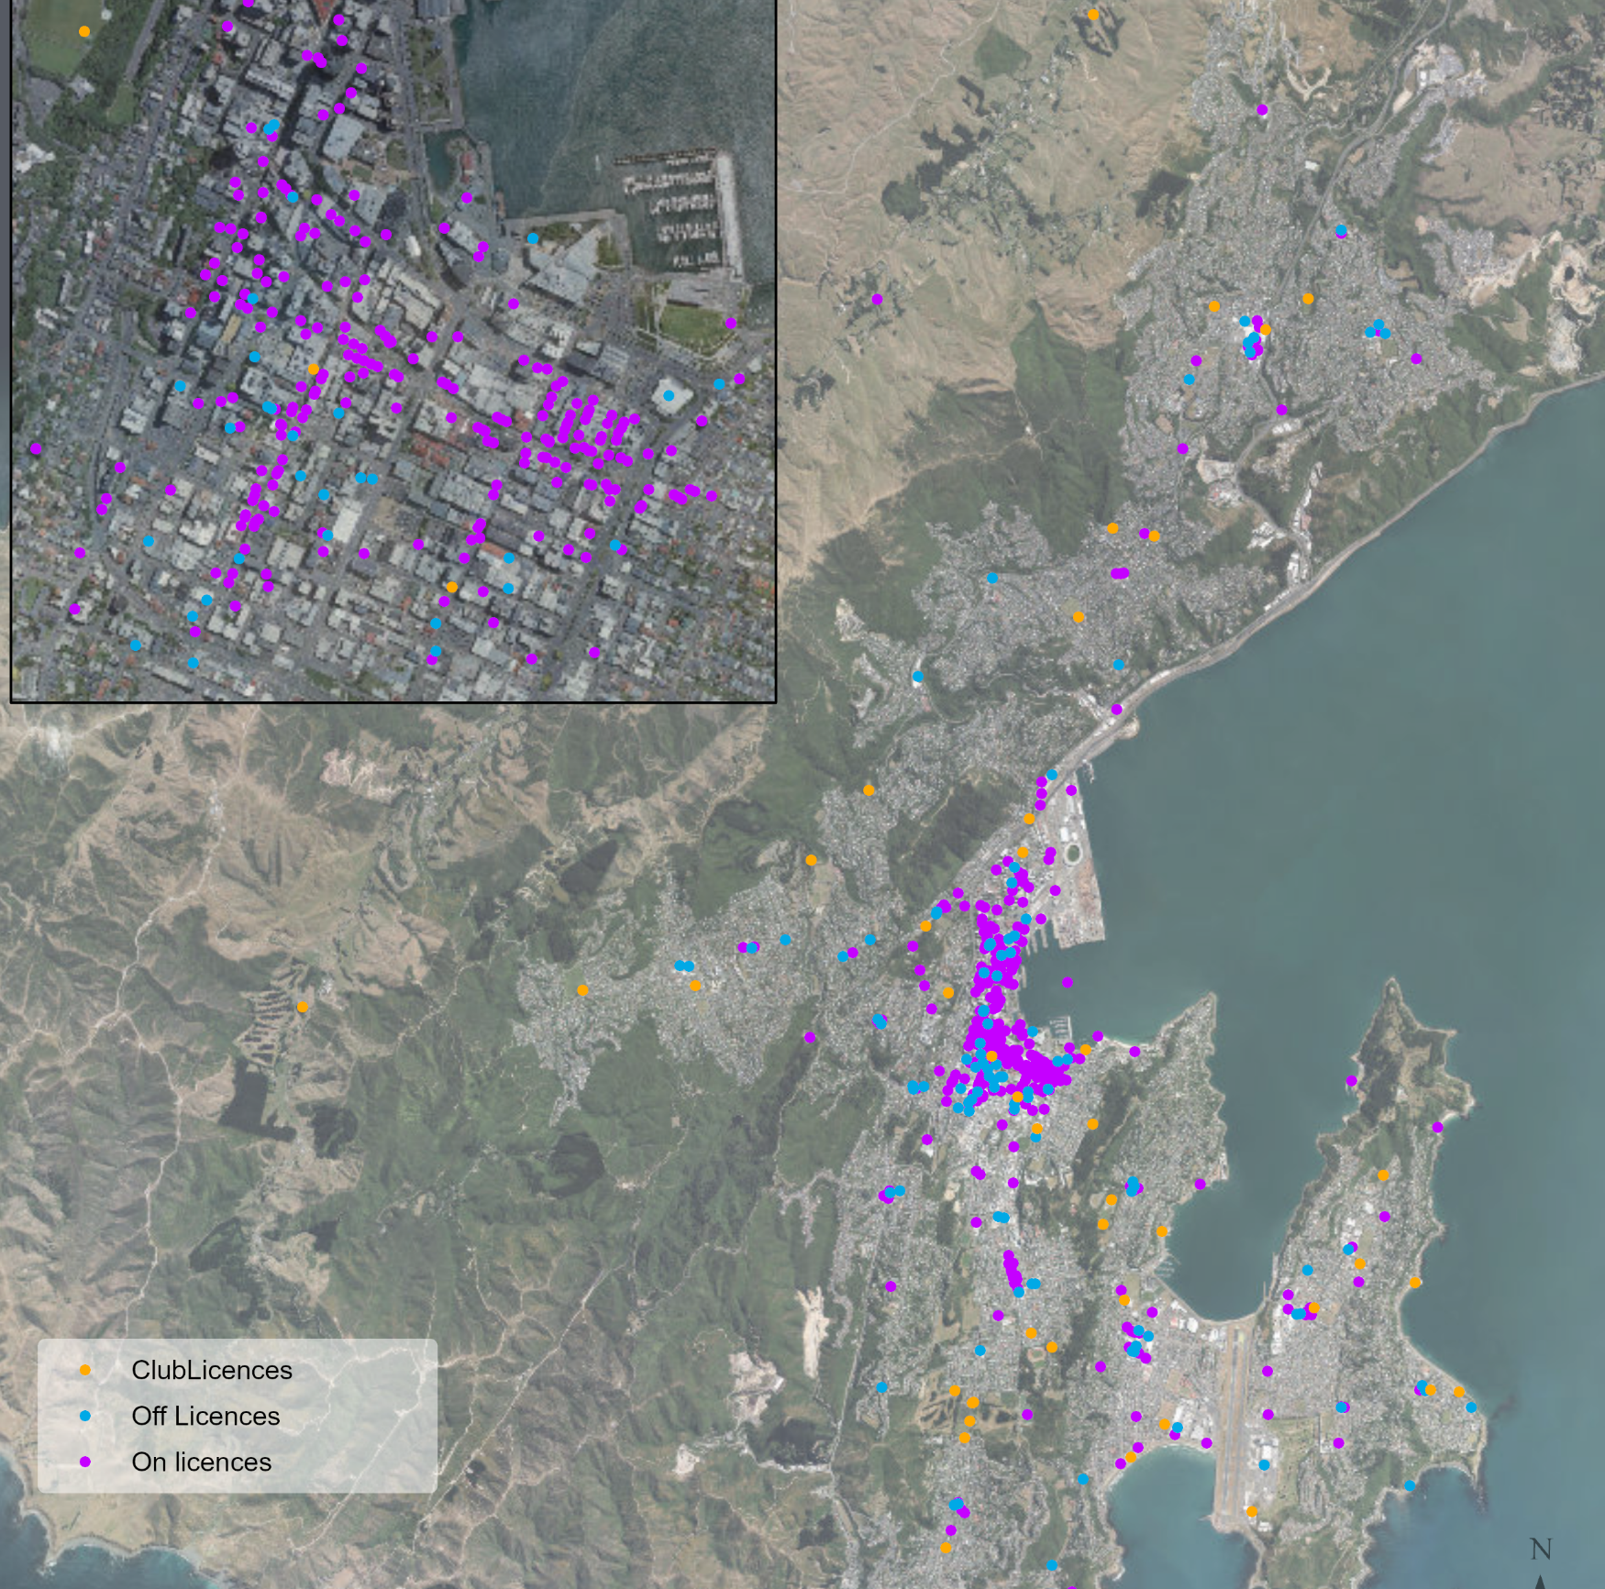
Licensing in Wellington
As of November 2024, there are 704 alcohol licences in total.
542 on-licences (alcohol is consumed on-site)
  262 restaurants
  157 taverns (pubs or bars)
110 off-licences (alcohol is purchased to take away)
  30 bottle stores
  23 grocery stores
  20 supermarkets
52 club licences (sports clubs, social clubs)
Number of premise licences over the past 5 financial years have been relatively stable across all categories.

Slide 12
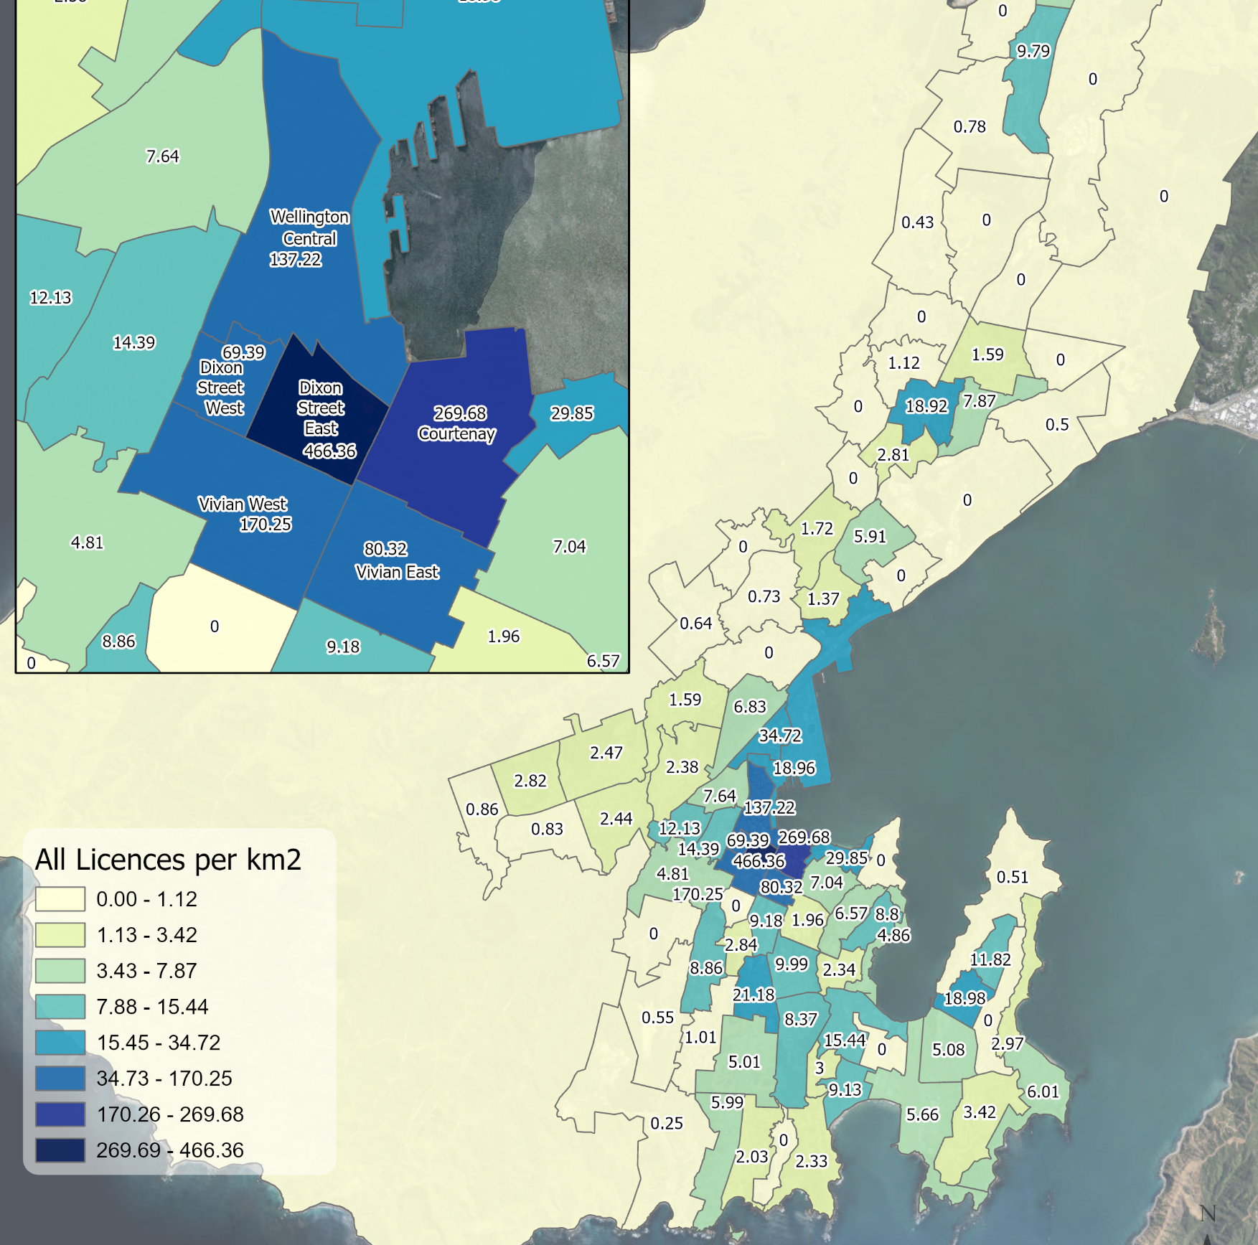
Licensing in Wellington
Number of licences by ward – central vs suburban
Ward | Total alcohol licences | On-licences | Off-licences | Club licences
Motukairangi / Eastern | 83 | 49 | 21 | 13
Paekawakawa / Southern | 58 | 38 | 11 | 9
Pukehīnau / Lambton | 464 | 401 | 52 | 11
Takapū / Northern | 57 | 30 | 16 | 11
Wharangi / Onslow-Western | 31 | 13 | 10 | 8

Slide 13
Business context – Wellington City
Drink – alcohol retailing, bars, pubs, taverns, sports/social clubs
Entertainment – creative and performing arts, performance venues, sports and recreation, health and fitness, gambling (TAB)
Food – cafes, restaurants, takeaway foods
57% of Wellington Region’s businesses (in this grouping) are in Wellington City.

Slide 14
Pattern of alcohol harm in Wellington
Later at night and during weekends
Most incidents in the central city followed by suburban centres of greater deprivation.

Slide 15
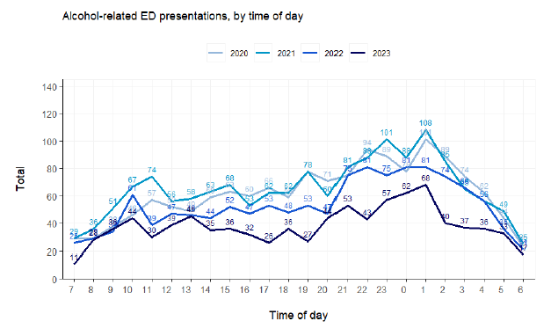
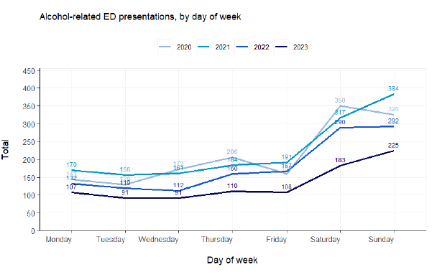
Alcohol-related ED attendances
Alcohol-related emergency department admissions occur more frequently later in the evening (between 8pm and 2am) and on weekends (Saturday and Sunday).

Slide 16
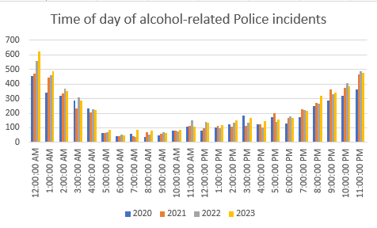
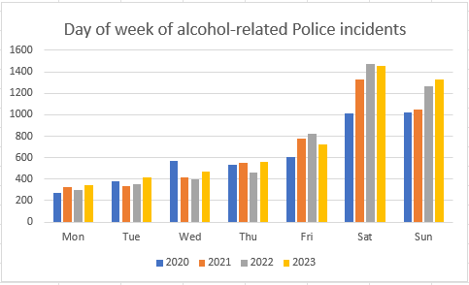
Alcohol-related Police incidents by time and day
Across Wellington, alcohol-related Police incidents occur more frequently later in the evening (9pm to 5am) and in the weekend (Saturday and Sunday).

Slide 17
What we know so far about community views

Slide 18
What do Wellington residents think?
A panel survey (~900 respondents) of Wellington residents in May-June 2024.
Most people drink moderately (2-4x a month, 1-2 standards each time).
The most popular place to buy alcohol from is the supermarket (63% do frequently).
Most people agree that alcohol has an important social/economic role in the city.
The most common harm reported is feeling unsafe in a public place due to another person’s drinking (44%).
Views on policy conditions
Limiting the number of licensed premises – 41% agree, 30% disagree, 20% neither.
Current alcohol sale hours across Wellington
  Off-licence premises - 55-65% about right, 21-30% a bit/much too long.
  On-licence premises – 42-47% about right, 42-45% a bit/much too long.
  Social/sports clubs – 38% about right, 47% a bit/much too long.

Slide 19
What do Wellington residents think?
A panel survey (~900 respondents) of Wellington residents in May-June 2024.
Licensed premises should be restricted in closeness to community facilities
  Bottle stores – 70% yes, 22% no
  Pubs/bars/nightclubs – 63% yes, 25% no
Priority facilities should be
  Schools (ECE, primary, secondary) – 86-88%
  Medical/rehabilitation facilities and hospitals – 66%
  Parks/playgrounds/sports facilities – 64%.
Licensed premises should be restricted in closeness to each other (free-text question) – 53% disagree, 41% agree.
One-way door restrictions across Wellington – 42% agree, 23% disagree, 20% neither.

Slide 20
Agency views – Police, Health NZ, Inspectors
  Meetings and workshop held in late 2025
  Top issues (contributing to excess drinking and harm)
  Pre-loading and side-loading
  Availability of/easy access to alcohol – density of licensed premises
  Pricing - affordable, ready to drink alcohol (including single serves)
  Promotions/advertising/social media
  Hours of sale
  Overstimulation, atmosphere, crowding of venues (lack of monitoring)
  Lack of public transport options.
Where most issues occur
Te Aro/Entertainment precincts - Courtenay Pl/Allen St, Dixon St, Cuba St, Waterfront (Frank Kitts/Waitangi)
Suburbs – Newtown, Kilbirnie, Johnsonville, Aro Valley, Island Bay.
Who is most affected
Young people (largely students 18-23) and minors
Vulnerable people – including homeless, Māori, people with addiction or mental health risk, sexual and gender minorities, elderly.
Notes:
Pre-loading starting out in the suburbs, side loading most visible in the CBD.
Atmosphere can contribute to more peer pressure to drink excessively. Overstimulation and a lot of people around can make it socially acceptable to be intoxicated.
Young people and minors are being influenced by gang members to use them for disorder. Young males receiving physical violence risk, young females feel unsafe and at risk of sexual violence. Young people are also demographic of people living in the central city, who are most affected.
Vulnerable people have greater health burden, can experience more harm from alcohol.

Slide 21
Amendment Bill
Sale and Supply of Alcohol (Improving Alcohol Regulation) Amendment Bill introduced to Parliament on 16 March 2026.
Proposes mostly technical and operational changes to the Act e.g. limiting objections to local community, allowing clubs to apply for on-licences.
Effect on local alcohol policies – cannot decline licence renewals if inconsistent with LAP.
  Grandfathering for existing licences, similar to vape retailing regulations.
Proposes to repeal conditions for special licences unless provided for in a LAP.
New national risk framework for special licences proposed in regulations but will take years to develop.
Wellington LAP an opportunity to fill in this interim gap.
Follows another bill (passed Royal Assent) – allowing alcohol sales on Anzac day morning, Good Friday, Easter Sunday, and Christmas Day.

Slide 22
Ngā mihi
  Thank you

Slide 23
Current rules - Wellington
No LAP is in force – national default rules.
Default national maximum trading hours (for the sale and supply of alcohol at premises):
On-licences and club licences – 8am to 4am the next day.
Off-licence retailers – 7am to 11pm.
All licence applications are determined on a case-by-case basis by the District Licensing Committee based on the criteria in the Act.
No specific limits on number, location, or type of licences.
Maximum trading hours and one-way door conditions may be negotiated for individual licences.

Slide 24
Key LAP rules in Wellington region
Council | On-licences | Off-licences | Other
Hutt City (2024) | Taverns/hotels/nightclubs/function centres: CBD & Jackson St, Petone Maximum hours 7am to 3am 1 year probation with 1am closing for new licences Outside of this area Maximum hours 7am to 1am 1 year probation for new licences | Maximum hours 7am to 10pm Maximum number of off-licences: Naenae – 4 Stokes Valley – 3 Taita – 3 Avalon – 1 Hutt Central – 11 Wainuiomata - 6 | Discretionary conditions regarding special licences (e.g. no glassware outside, plastic containers or cans, promotion of responsible alcohol use)
Porirua City (2025) | Maximum hours 8am to 2am On-licence hotels can trade at any time on any day to lodgers Same rules apply to club licences, except RSAs can trade from 4am to 1pm on ANZAC day | Maximum hours 9am to 9pm Freeze with rebuttable presumption on any new off-licences in 4 priority areas. Remote sellers can trade at any time/day. Discretionary conditions (buy now pay later, single sales, advertising, remote sellers and on-demand delivery) | No licences will be granted in close proximity to sensitive sites (schools, drug/alcohol treatment providers) Discretionary conditions for club licences (manager onsite after 9pm, serve wise training)
Wairarapa District Councils (2024) | Maximum hours 8am to 1am Hotel in-bedroom (mini-bar) and/or lodgers sales have 24 hour trading Discretionary condition for BYO restaurants to require a duty manager during busy periods e.g. Thursday, Friday, Saturday nights | Maximum hours 7am to 10pm - supermarkets and grocery stores All others 9am to 10pm No new licences granted within 100m of sensitive sites (except supermarkets, grocery stores) | Maximum hours 8am to 11pm for Sports Clubs 8am to 1am for other Club licences Special licences will not be granted for events focused on children

Slide 25
Key LAP rules in metro councils
Council | On-licences | Off-licences | Other
Auckland (2024) | Maximum hours 8am to 4am in the City Centre 8am to 3am for the rest of the region | Maximum hours 7am to 9pm Temporary freeze on new licences in the City Centre and Priority Overlay areas for 24 months Rebuttable presumption against new licences in Neighbourhood Centres | Club licences maximum hours 9am to 1am Special licences should not exceed maximum hours for on-licences in the area
Tauranga (2024) | Maximum hours 9am to 2am in the city centre 9am to 1am elsewhere Same rules apply to club licences | Maximum hours 7am to 10pm No new licences issued for bottle stores within suburbs with a social deprivation index of 9 or 10 | Discretionary conditions for special licences (e.g. limit of drinks sold per transaction, no high alcohol shots)
Dunedin (2018) | In non-residential areas: Hotels, taverns 8am to 3am One-way door at 2.30am Restaurants/cafes 8am to 1am Entertainment premises 5pm to 4am One-way door at 2.30am | Maximum hours 7am to 10pm Exception to sale restriction on Easter Sunday – grape, fruit or vegetable wine made on the premises or where produce is grown on the land e.g. a vineyard | Licences for new hotels, taverns or bottle stores will not generally be granted if they are within 100m of a sensitive facility likely to attract young people, such as schools and playgrounds
Christchurch (2025) – off-licences only
Maximum hours 7am to 9pm
Freeze on new off-licences in high deprivation areas
Bottle stores limited in location to schools, addiction facilities, bus interchange (various distances from 50m to 200m)

Slide 26
Agency views – Police, Health NZ, Inspectors
  Meetings and workshop held in late 2025
  Effective licensing/LAP conditions
  Reduce hours (particularly for off-licences and also high risk on-licences and clubs)
  Spreading out high-risk on-licences (taverns/night clubs), no new off-licences in CBD
  Strengthening host responsibility (CCTV, queue management, SCAB tool)
  Point of sale conditions for off-licences (limits on single serves and chilled drinks, remote sale age and intoxication checks, buy-now-pay-later)
  Limits on pricing, promotions (2 for 1), advertising, social media, bottomless brunches
  One-way door conditions.
Priority licence types (for a LAP)
Off-licences (in priority areas) – supermarkets (low cost of alcohol)
On-licences – taverns and night clubs
Clubs – rugby/sports clubs
Events – sales by stores during street festivals, less so event licences
Notes:
SCAB tool – test for intoxication/sobriety for bars. Speech, coordination, appearance, behaviour

Slide 27
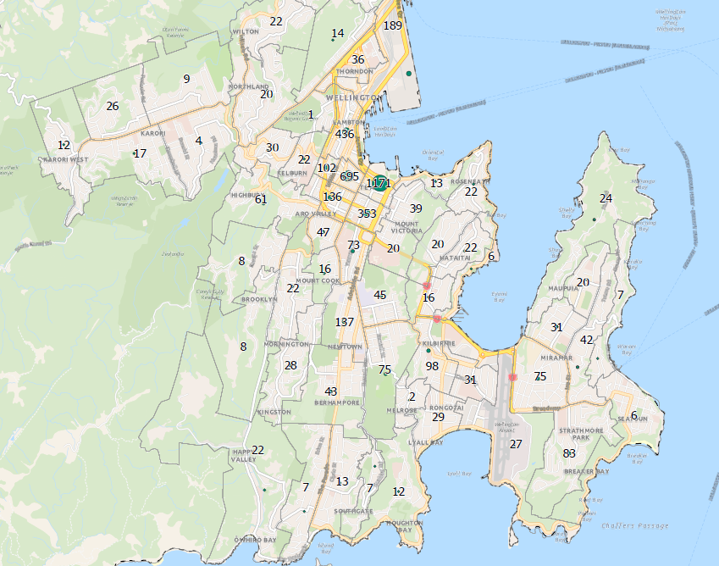
Alcohol-related Police incidents
Most alcohol-related Police incidents (including alcohol ban breaches) in 2023 occurred in the central city (Te Aro).
This is followed by suburban centres with greater socioeconomic deprivation.

Slide 28
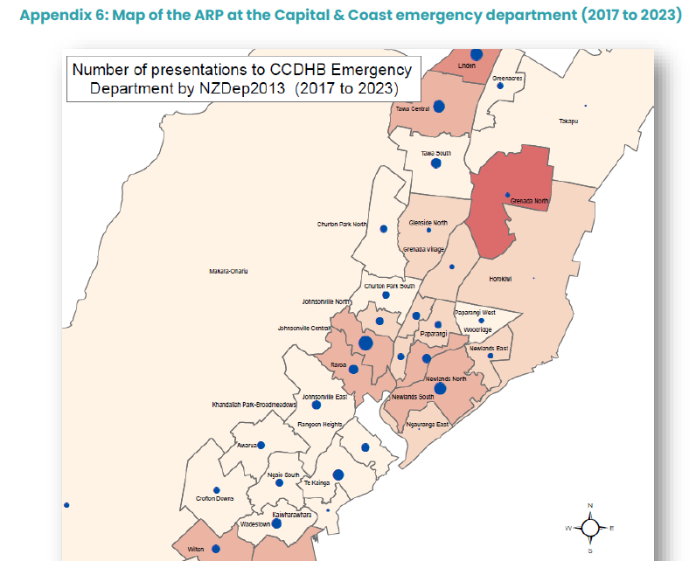
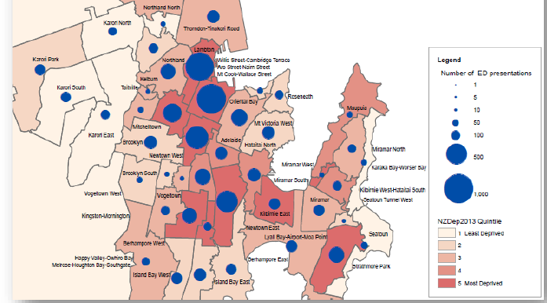
Alcohol-related ED attendances
Alcohol-related emergency department admissions occur more frequently for people who reside in the central city and in areas of greater socioeconomic deprivation.

Slide 29
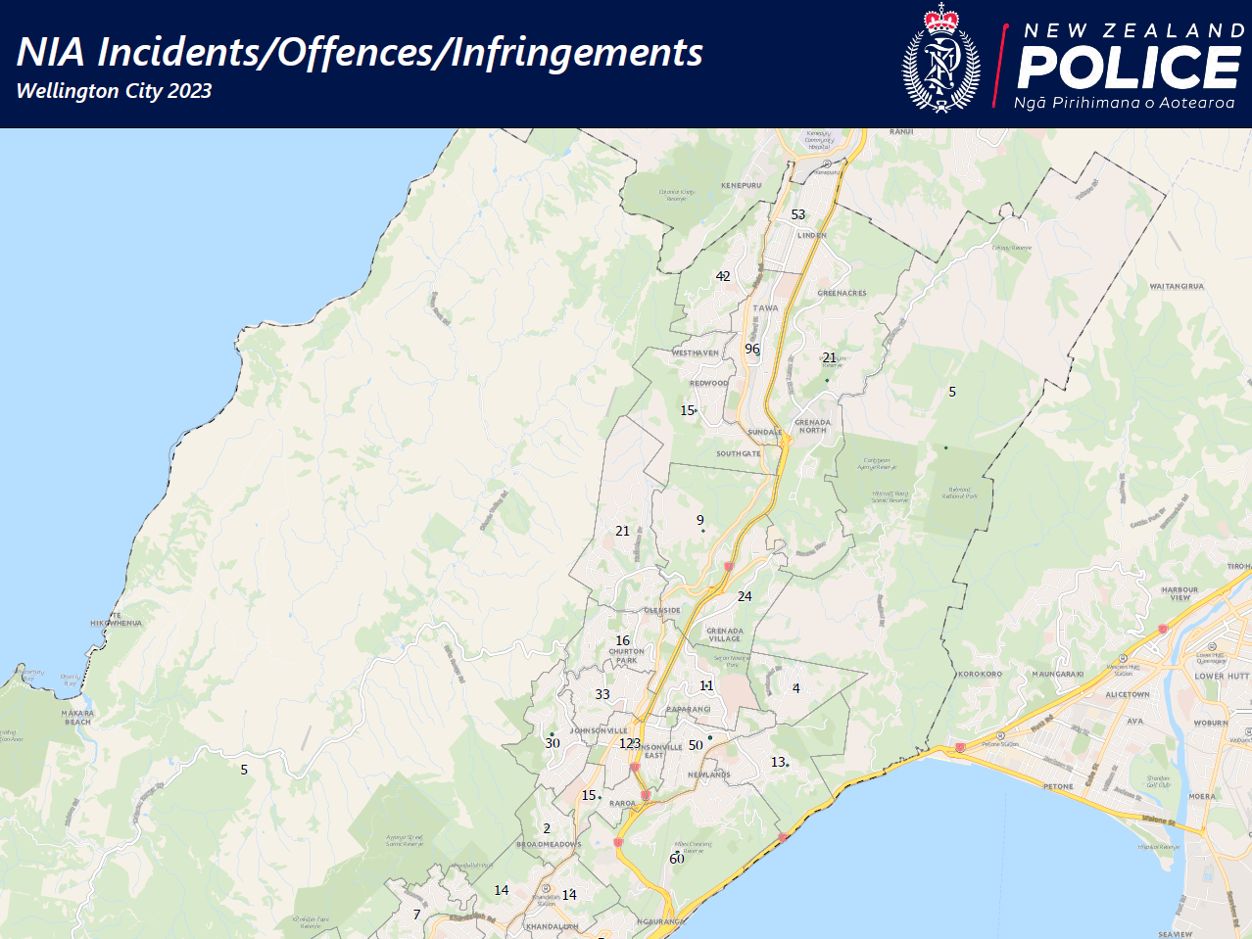
Alcohol-related Police incidents

Slide 30
Licensing in Wellington
Number of premise licences over the past 5 financial years have been relatively stable across all categories.
Annual reports to ARLA (national licensing authority) by Wellington DLC
Year (at 30 June) | On-licences | Off-licences | Club licences | Total (excluding special licences)
2021 | 508 | 127 | 54 | 689
2022 | 523 | 120 | 51 | 694
2023 | 511 | 106 | 49 | 666
2024 | 533 | 115 | 51 | 699
2025 | 523 | 120 | 51 | 694

